Slide 1


Slide 2
NLP in Business Analytics

Slide 3
Hello!
I am Adil Sheikh

Slide 4
Topics for today’s Session
What is Topic Modeling
Why is it the 🔥 topic in Business
Solve a business problem using Topic modeling
Building a topic model from scratch using BERTTopic
Presenting the solution to the Business

Slide 5
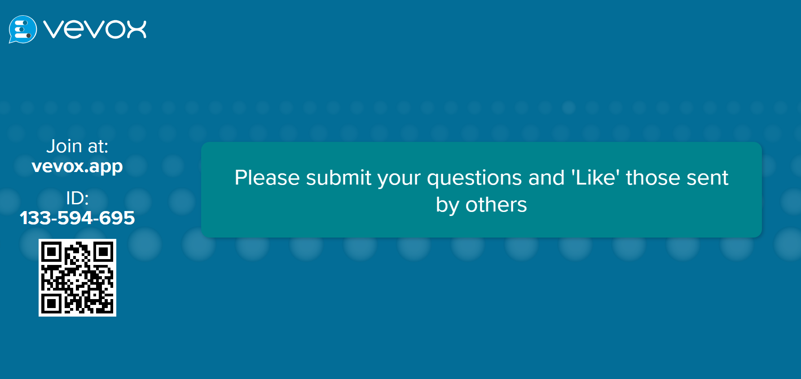

Slide 6



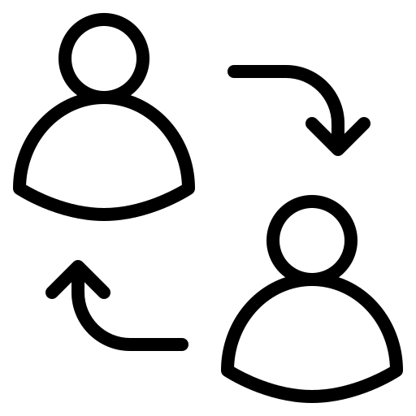


TELETECH
23 yrs
experience in CX
Digital Transformation
Conversational Data

Slide 7
TELETECH
“
1.7 million hours of call Record ~ 194 years of audio

Slide 8



Analytics Services

Slide 9


Dataset:
Conversational dataset:

Slide 10
Audio Transcript
Agent: sorry to hear that you're having trouble with your order. You may have your order number, please. Yeah,
Customer: order number so it's 2576567
Agent: okay, thank you for providing that. Can you give me a moment to check your records, please? Yeah, sure. Okay, I see that you ordered a console. Can you tell me more about the issue you're experiencing with it?
Customer: basically, I got it, but it's come back damaged. I sent a photo to the support email, so you should have got that on your side. So, I just want to follow up on that request.
Agent: that you would like a replacement item. That's no problem at all. I will process that for you right away. Okay, great. Too easy. You're welcome. Your replacement item will be shipped out to you within the next two business days, and you should receive it within a week. Is there anything else I can assist you with? No, that's it. Thanks very much. You're welcome. We apologize again for the inconvenience this has cost you, and we appreciate your patience as we resolve this issue for you. Please don't hesitate to reach out to us if you have any further questions or concerns. Thank you.

Slide 11
Answer
Order was damaged

Slide 12
BERTopic
BERTopic is a topic modeling technique that leverages BERT embeddings and clustering algorithms to identify topics in textual data.
Unlike traditional methods like LDA, BERTopic captures contextual relationships between words using transformer-based models.

Slide 13
Flow of model building
Step 1: Importing dataset
Step 2: Pre-process dataset (Skip)
Step 3: Use the pre-processed dataset to build a topic model
Step 4: Fine-tune the output
Step 5: Pass the output to Business Analyst

Slide 14
Business Problem
"Businesses aim to identify customer issues to optimize the production of essential parts."

Slide 15


Slide 16
Thanks!
Any questions?
You can find me at:
Adil.sheikh97@gmail.com

